Slide 1
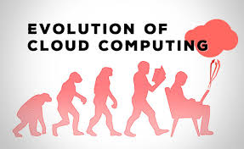
Lecture 8: Evolution of Cloud Computing

Slide 2
Lecture Recap
Activity #1
What cloud computing services have you used so far?
Why cloud computing so popular now?
What is the first business for Amazon.com?
What did Microsoft name its cloud services as _______ ?

Slide 3
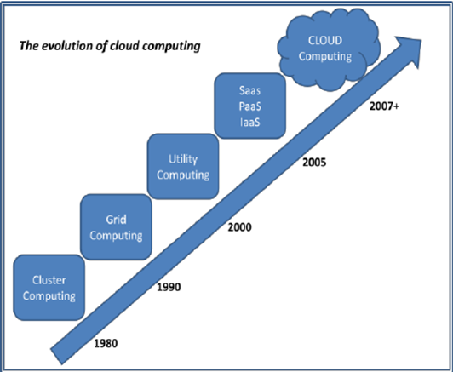
researchgate.com

Slide 4
Parallel Computing and Clustering
Parallel computing
Concepts proposed in 1950s; technology booming in 1980s
uses multiple processing elements simultaneously to solve a problem
Divide-and-conquer
breaking the problem into independent parts
Solved simultaneously
Combining partial solutions into the final result
Computing resources
single computer with multiple processors, several networked computers, specialized hardware, or any combination of the above
Computer clusters
Heterogeneous okay, scalable preferred, …

Slide 5
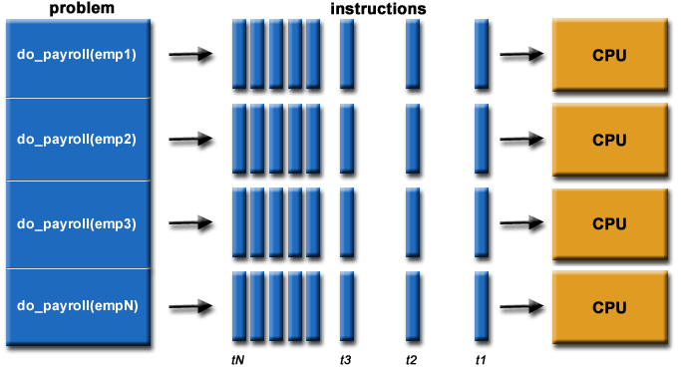
Parallel computing: A problem is divided into subprograms, each processed by a separate computing node.
https://computing.llnl.gov/tutorials/parallel_comp/

Slide 6
Distributed Computing
Distributed Computing
Using distributed systems to solve large problems.
Distributed System: multiple autonomous computers connected through a communication network
The system has a distributed memory where each processor has its private memory.
Communication: Information exchanged using communication models, ex: MPI

Slide 7
Parallel vs. Distributed Computing
Distributed computing usually implies parallel computing (not vise versa)
Can have parallel computing on a single/sequential machine
Some common assumptions (not exactly conform to theoretical definitions)
Parallel machines are physically close to each other, say in the same server room; connected with dedicated high-speed LANs and switches; communication cost assumed to be small; can have shared-memory; …
Distributed machines can far from each other (e.g. in different continents); connected with public networks such as the Internet; communication cost/problems cannot be ignored; usually using message-passing model

Slide 8
Distributed Computing Expanded …
Cluster Computing Characteristics
tightly coupled computers
single system image
Centralized Job management & scheduling system
Better performance and availability and more cost‐ effectiveness over single computer with same capabilities
Since 1980s
Grid Computing Characteristics
loosely coupled
no Single System Image
distributed Job Management & scheduling
Originated early 1990s

Slide 9
Cluster: a sample image
https://en.wikipedia.org/wiki/Computer_cluster

Slide 10
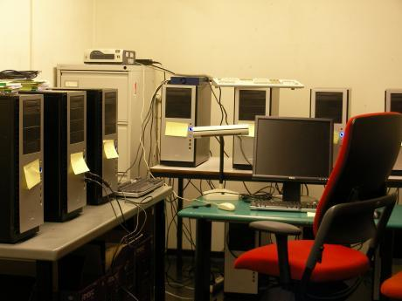
A small cluster

Slide 11
Grid Computing
Uses a collection of computing resources from multiple locations to reach a common goal.
a form of distributed computing whereby a “super virtual computer” is composed of many networked loosely coupled computers acting together to perform large tasks.
For certain applications, “distributed” or “grid” computing, can be seen as a special type of parallel computing
Grid
can be thought of as a distributed system with non-interactive workloads that involve a large number of files
more loosely coupled, heterogeneous, and geographically dispersed
while clusters usually more tightly coupled, in particular traditional supercomputers have many processors connected by a local high-speed network.
Grid size varies a considerable amount.
Example
SETI@home Project (http://setiathome.berkeley.edu/)

Slide 12
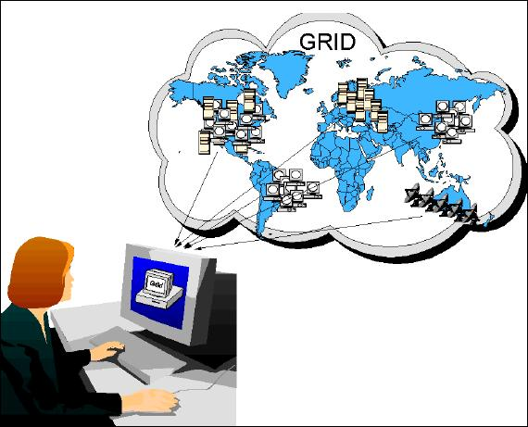
Illustration of a grid
http://coitweb.uncc.edu/~abw/itcs4010f05/index.html

Slide 13
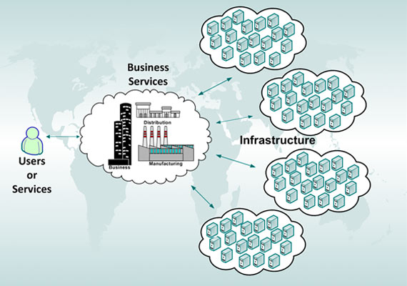
Utility Computing
Recall what covered in Lecture 7

Slide 14
Utility Computing
The term utility refers to utility services such as electricity, gas, …
Utility computing allows companies to only pay for the computing resources they need, when they need them (i.e. pay per use)
Cloud computing, grid computing and managed IT services are based on the concept and business model of utility computing.

Slide 15
Activity #2 (pop-quiz)
1. I have a powerful desktop or laptop computers with 8 cores and powerful GPUs. I am running a game with intensive computation on it. Is this
a. utility computing b. parallel computing
c. distributed computing d. other (please specify)
2. I built up a small cluster using 4 laptops connected via local area networks or internets. I am running a game with intensive computation which uses all 4 laptops. Is this
a. utility computing b. parallel computing
c. distributed computing d. other (please specify)
3. I don’t own a computer but I used my friend’s powerful desktop with 8 cores and GPUs to play game. I pay my friend $2 for each hour I played. Is this
a. utility computing b. parallel computing
c. distributed computing d. other (please specify)

Slide 16
Cloud Computing
Think of it as Internet Computing
Computation done over the internet
Enabled through
High Bandwidth and High Speed Internet
Utility Computing
Virtualization
…
Cloud computing metaphor: the group of networked elements providing services need not be individually addressed or managed by users; instead, the entire provider-managed suite of hardware and software can be thought of as an amorphous cloud.
https://en.wikipedia.org/wiki/Cloud_computing

Slide 17
Cloud Computing vs. Grid Computing
both trying to organize all kinds of the heterogeneous IT resource as a service into the resource pool
grid computing tries to use all kinds of resources to finish one application, while the cloud computing tries to use all kinds of resources to finish all kinds of applications.
Although the grid can process the job using different physical machines, it needs the user to write the parallel algorithm and divide the whole job into sub-jobs to run under different physical nodes.
Cloud computing integrates all the physics machine resources through virtualization

Slide 18
Some interesting videos …
Note: if these video links are not accessible, may use any available video on cloud computing as substitutes.
Cloud Computing
https://www.youtube.com/watch?v=QJncFirhjPg
https://www.youtube.com/watch?v=ae_DKNwK_ms
SaaS http://www.youtube.com/watch?v=kGUPSvswmY0&feature=related
Virtualization
http://www.youtube.com/watch?v=p11lJOnALS4&feature=related

Slide 19
Summary
Evolution of cloud computing
Utility computing
Cost effectiveness
Business model
Grid computing, parallel and distributed computing
Technical foundation
Cloud computing
Next Lecture
Cloud Computing Models and Types
Exploring SaaS services via Amazon AWS S3.
Activity #3:
Do an online research to find the cost of using cloud services from three different cloud providers of your choice.
Explain why cloud services are significantly more cost-effective than traditional computing services.

